Slide 1
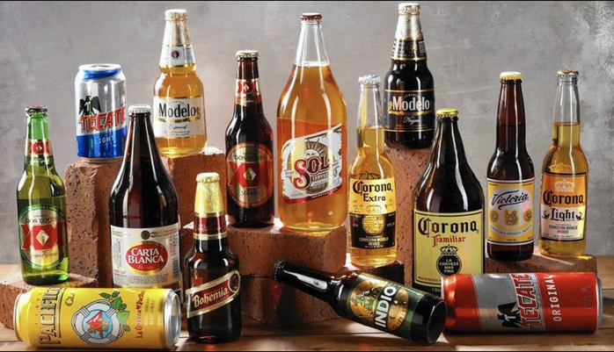
Beer Recommendation System
Zixiang Wen
Department of Plant, Soil and Microbial Sciences
Michigan State University
Notes:
I am glad to be here to talk about what we have done during last year.

Slide 2
1. Introduction
Objective:
Build a recommendation system to leverage users historical ratings to create predictions for un-tasted beers and create a personalized recommendation for which beer to sample next.
Target audience:
Beer enthusiast
Breweries operating in the US

Slide 3
1.1 Data source information
Download address:
https://www.kaggle.com/rdoume/beerreviews
Table 1 Features information from beer reviews dataset
Feature name | Count | Missing | Type | Note
brewery_id | 1586614 | 0 | int64 | An identifier for the brewery
brewery_name | 1586599 | 15 | object | The name of brewery
review_time | 1586614 | 0 | int64 | when the review was submitted
review_overall | 1586614 | 0 | float64 | Rating of the beer overall (1.0 to 5.0)
review_aroma | 1586614 | 0 | float64 | Rating of the beer's aroma (1.0 to 5.0)
review_appearance | 1586614 | 0 | float64 | Rating of the beer's appearance (1.0 to 5.0)
Re_profilename | 1586266 | 348 | object | The profile name of the reviewers
beer_style | 1586614 | 0 | object | The style of beer
review_palate | 1586614 | 0 | float64 | Rating of the beer's palate (1.0 to 5.0)
review_taste | 1586614 | 0 | float64 | Rating of the beer's taste (1.0 to 5.0)
beer_name | 1586614 | 0 | object | Name of the beer
beer_abv | 1518829 | 67785 | float64 | The alcohol by volume of the beer
beer_beerid | 1586614 | 0 | int64 | A unique ID indicating the beer reviewed

Slide 4
1.2 Data cleaning
Table 2 Main cleaning steps for the dataset
Feature name | Cleaning steps
brewery_name | Drop missing value. Keep name started with letter or number (a-zA-Z0-9)
review_time | Convert to YYYY-MM-DD format
review_profilename | Fill ‘nan’ with ‘Unknown’
beer_abv | Fill missing value with average value
beer_beerid | Count the number of id. Discard the id with review count <5
5 review indexes* | Discard the review small than 1 and larger than 5

Slide 5
2. Data Exploration
2.1 Describe statistics
Table 3 Describe statistics of the 5 review indexes and alcohol content for beers
 | review _overall | review _aroma | review _appearance | review _palate | review _taste | beer_abv (%)
Count | 19209 | 19209 | 19209 | 19209 | 19209 | 19209
Mean | 3.71 | 3.62 | 3.74 | 3.63 | 3.66 | 6.58
Std | 0.45 | 0.48 | 0.38 | 0.44 | 0.50 | 2.18
Min | 1.14 | 1.17 | 1.50 | 1.23 | 1.15 | 0.05
25% | 3.50 | 3.40 | 3.57 | 3.42 | 3.42 | 5.00
50% | 3.79 | 3.69 | 3.81 | 3.70 | 3.75 | 6.00
75% | 4.00 | 3.94 | 4.00 | 3.92 | 4.00 | 7.80
Max | 4.94 | 5.00 | 4.93 | 4.94 | 4.94 | 41.00
Describe statics showed that there are no big variations existing in features probably due to fixed rating range from 1 to 5. For instance, the overall review(review_overall) varies from 1.14 to 4.9 with a mean of 3.71. However, we observed large variation for the alcohol content (beer_abv), which varies from 0.05% to 41% with a mean of 6.58%.

Slide 6
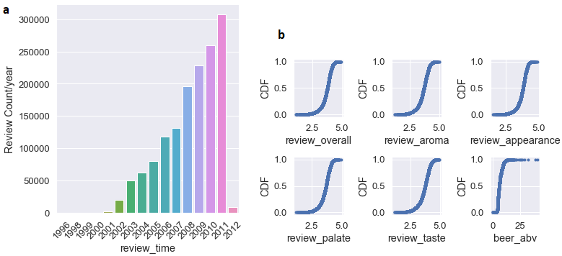
Figure 1 Review time (a) distribution and review indexes (b) cumulative distribution

Slide 7
2.2 Ranking and sorting beer brand, style and brewery
Table 4 Top ten the most popular beer brand
Rank | Beer Name | Review average
1 | Alesmith Speedway Stout - Vanilla And Coconut | 4.887500
2 | El Gordo | 4.828571
3 | M Belgian-Style Barleywine | 4.735714
4 | Capricho Oscuro - Batch 1 | 4.716667
5 | Coffee Infused Imperial Stout Trooper | 4.700000
6 | Cantillon La Dernière Cuvée Du 89 | 4.683333
7 | Barrel Aged Stout | 4.680000
8 | Armand'4 Oude Geuze Lente (Spring) | 4.673846
9 | Kopi Con Leche Stout | 4.671429
10 | Hitchhiker | 4.666667
The number 1 of most popular beer is Alesmith Speedway Stout - Vanilla And Coconut. This brand of beer has chocolate and roasted malts dominate the flavor, supported by notes of dark fruit, toffee, and caramel

Slide 8
Table 5 Top ten the most popular beer style
Rank | Beer style | Review AVG*
1 | Quadrupel (Quad) | 4.135505
2 | American Double / Imperial Stout | 4.131664
3 | Russian Imperial Stout | 4.113477
4 | American Wild Ale | 4.097805
5 | Eisbock | 4.088967
6 | Gueuze | 4.084845
7 | American Double / Imperial IPA | 4.061975
8 | Lambic - Unblended | 4.038159
9 | Weizenbock | 4.034948
10 | Flanders Red Ale | 4.026596
The most popular beer style is Quadrupel (Quad). Inspired by the Trappist brewers of Belgium, the Quadrupel is a Belgian-style ale of great strength with even bolder flavor compared to its sister styles Dubbel and Tripel.

Slide 9
Table 6 Top ten highly rated brewery
Rank | Brewery Name | Brewery ID | Review AVG
1 | Brouwerij Westvleteren | 313 | 4.51
2 | Närke Kulturbryggeri AB | 10902 | 4.48
3 | The Alchemist | 27039 | 4.47
4 | Micro Cervejaria Falke Bier | 10287 | 4.47
5 | Old Chimneys Brewery | 6560 | 4.43
6 | Benny Brewing Company | 24757 | 4.42
7 | Kane Brewing Company | 26676 | 4.41
8 | Denison's Brewing Company & Restaurant | 662 | 4.40
9 | Breakwater Brewing | 17988 | 4.38
10 | Brauerei Zehendner GmbH | 5983 | 4.38

Slide 10
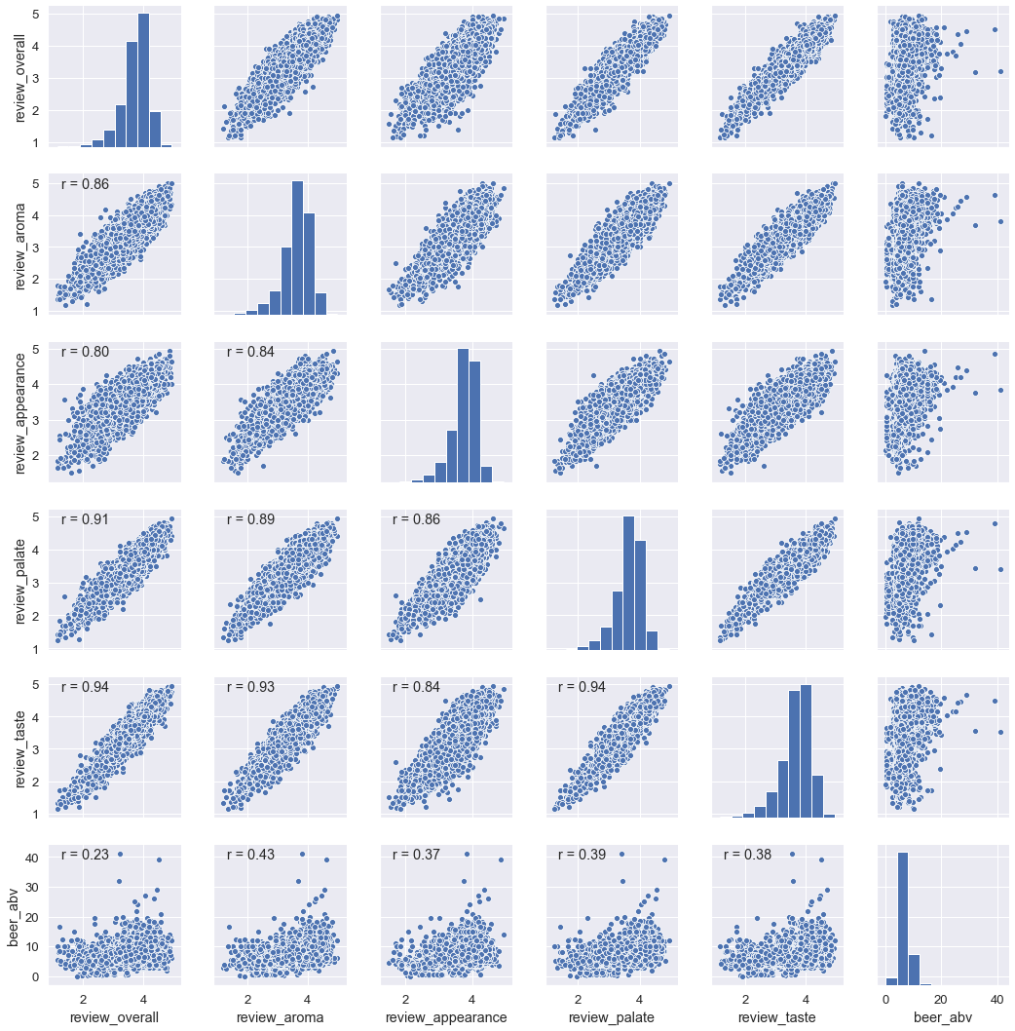
2.3 Relationship among the features
Figure 2 Histogram and scatter plot showing the relationships among the features.

Slide 11
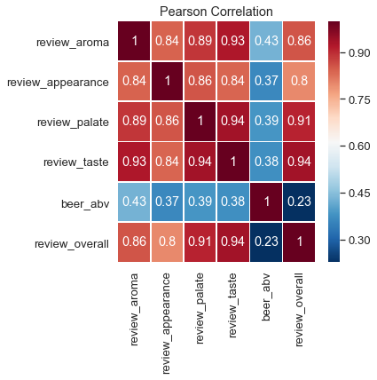
Figure 3 Correlation coefficient among 5 review indexes and alcohol content
The correlation coefficient between alcohol content and the 5 review indexes is relatively low with range of 0.23 to 0.43. The results suggest that alcohol content dose not play important role for beer rating. The histogram of the 5 review indexes (Fig. 2) showed that rating score slightly skewed to right side indicated that there are more people like the beer they rated than who did not.

Slide 12
Table 7 The p-value for testing non-correlation were calculated for all pair-wise features
 | review_overall | review_aroma | review_appearance | review_palate | review_taste
review_aroma | 0.0
review_appearance | 0.0 | 0.0
review_palate | 0.0 | 0.0 | 0.0
review_taste | 0.0 | 0.0 | 0.0 | 0.0
beer_abv | 9.28e-274 | 0.0 | 0.0 | 0.0 | 0.0

Slide 13
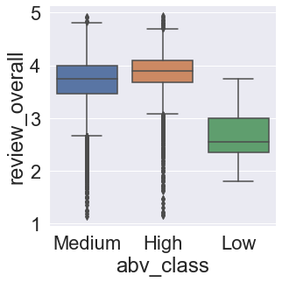
2.4 Relationship between the beer alcohol content and rating score
Figure 4 Box plot showing the difference in rating among three ABV classes
Table 8 ANOVA analysis of rating difference among different ABV classes
 | Sum_sq | df | F | PR(>F)
abv_class | 128.00 | 2 | 319.42 | 3.43E-137
Residual | 3848.39 | 19206 | NaN | NaN

Slide 14
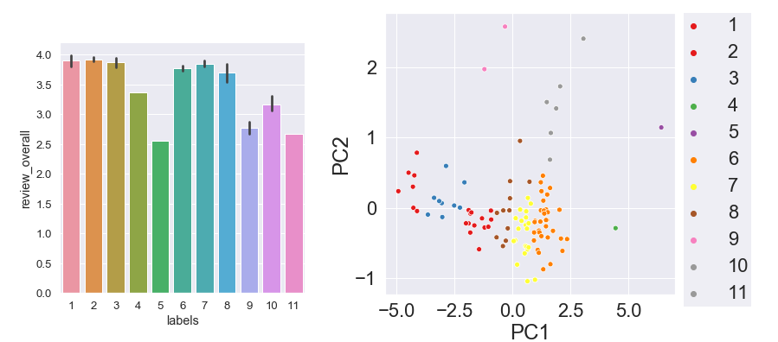
2.5 Relationship between the beer style and rating
Figure 6 Bar plot and scatter plot showing the difference in rating score among 11 clusters and beer style distribution

Slide 15
3.Building and testing recommender systems with Surprise
3.1 Choose the best algorithms
Table 9 Algorithms comparison for the beer dataset
Algorithm | test_rmse | fit_time | test_time
SVDpp | 0.598 | 7313.033 | 337.3621
BaselineOnly | 0.601 | 3.928861 | 6.072451
KNNBaseline | 0.602 | 82.24511 | 232.1964
SVD | 0.604 | 77.26623 | 6.828465
KNNBasic | 0.620 | 76.56187 | 209.4991
NMF | 0.625 | 79.14518 | 5.830669
KNNWithMeans | 0.625 | 77.10334 | 219.8093
CoClustering | 0.666 | 40.16992 | 6.11246
NormalPredictor | 0.989 | 2.286215 | 6.465656
SVDpp algorithms has best performance with the lowest RMSE (0.5975). However, this algorithm is also the most time-consuming one

Slide 16
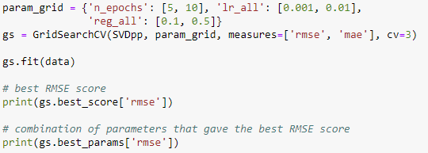
3.2 Tuning and evaluating the SVDpp model
Hyperparameters tuning:
The results showed that best hyperparameters combination is 10 for n_epochs 10, 0.01 for lr_all, and 0.1 for reg_all. The corresponding accuracy measured by RMSE score was 0.603.

Slide 17
3.3 Making recommendations with SVDpp model
Table 10 Top 10 the best predictions for the test dataset
uid | iid | rui | est | Details (was_impossible) | Iu | Ui | err
oteyj | 44910 | 5 | 5 | False | 67 | 28 | 0
oteyj | 51116 | 5 | 5 | False | 67 | 131 | 0
FARGO619 | 21690 | 5 | 5 | False | 36 | 472 | 0
FARGO619 | 7971 | 5 | 5 | False | 36 | 1907 | 0
billzav | 7971 | 5 | 5 | False | 21 | 1907 | 0
paxtonthegreat | 7971 | 5 | 5 | False | 10 | 1907 | 0
lemasney | 7971 | 5 | 5 | False | 78 | 1907 | 0
oteyj | 731 | 5 | 5 | False | 67 | 1472 | 0
kdawg105 | 6549 | 5 | 5 | False | 53 | 991 | 0
hippityead24 | 7971 | 5 | 5 | False | 23 | 1907 | 0
Note: uid — the user ID, for whom we carry out predictions, iid — item ID (here we treat movies as items), est — estimated rating for an item, as we expect the user to give, Ui : the set of all users that have rated item i. Iu : the set of all items rated by user u. err, the difference between predicted and true value.

Slide 18
Table 11 The best recommendation for user NaLoGra
Brewery name | Beer name | Beer id | Predicted rating
Southampton Publick House | Southampton Berliner Weisse | 8626 | 4.87
Kern River Brewing Company | Citra DIPA | 56082 | 4.77
Brouwerij Drie Fonteinen | Geuze Cuvée J&J Blauw (Blue) | 23413 | 4.8
Brouwerij Drie Fonteinen | Armand'4 Oude Geuze Zomer (Summer) | 70356 | 4.8
Brouwerij Drie Fonteinen | Armand'4 Oude Geuze Lente (Spring) | 68548 | 4.89
Brouwerij Drie Fonteinen | Geuze Cuvée J&J | 23414 | 4.76
The Lost Abbey | Veritas 004 | 45957 | 4.81
The Lost Abbey | Veritas 005 | 54147 | 4.79
FiftyFifty Brewing Co. | Imperial Eclipse Stout - Pappy Van Winkle | 47668 | 4.77
Brouwerij Westvleteren | Trappist Westvleteren 12 | 1545 | 4.76

Slide 19
4. Discussion and Summary
A beer recommendation system with SVDpp algorithm was built.
The age of the data is something that in future analysis can and should be considered.
Geographical information should be taken into account in the recommendation engine.
Deep learning, such as Autoencoders and Restricted Boltzmann machines, should be used in the future.

Slide 20
Thanks for your attention!

